Slide 1
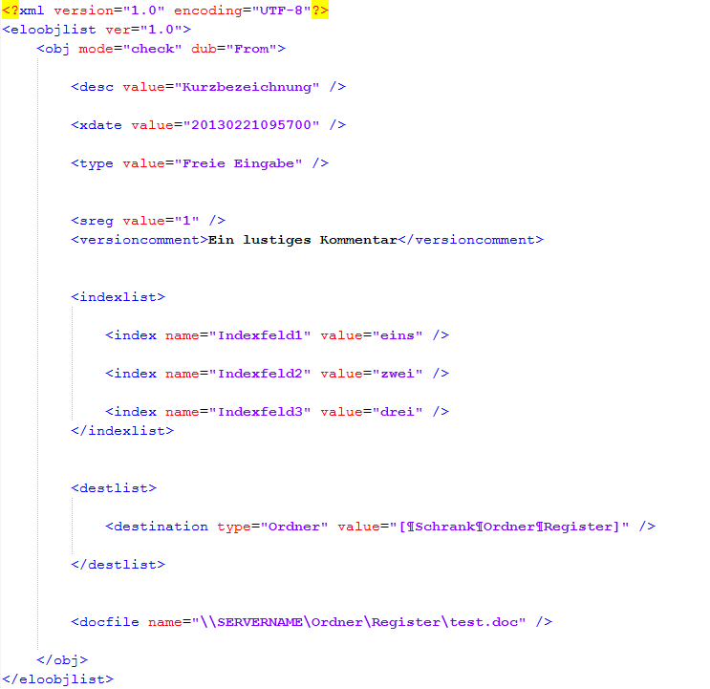
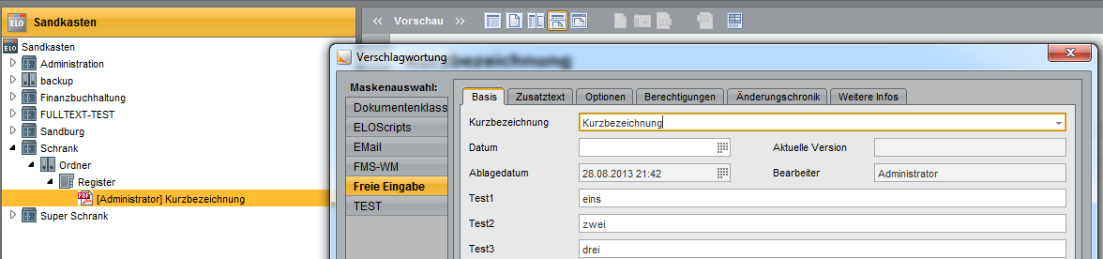
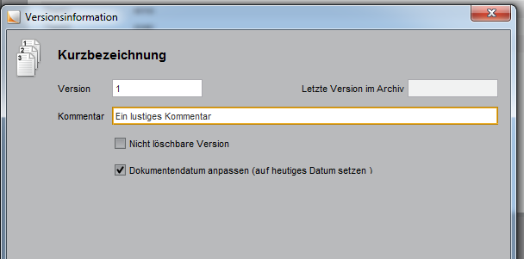
Name of the document
1
Archinving-date
2
3
Name of the keywording mask
4
Version-number
Version-comment
5
Groupfiledname of an indexline
1
Indexing
3
2
6
Value of an indexline
6
One indexline
7
Destination in ELO-Repository
File to import
4
5

